Slide 1
CT474: Smart Grid Lecture 1: Introduction to Data Science with R
Dr. Jim Duggan,
School of Engineering & Informatics
National University of Ireland Galway.
https://github.com/JimDuggan/EnergyAnalytics
https://twitter.com/_jimduggan

Slide 2
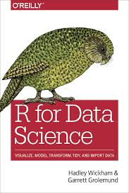
Topic Structure
Introduction to Data Science and R
Data Visualisation
Data Transformation
Data Modeling
R Aspects
ggplot2
dplyr
lm
Energy examples

Slide 3
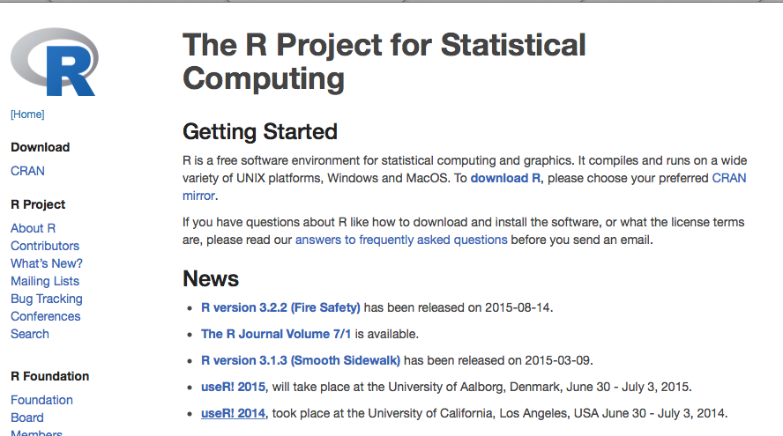
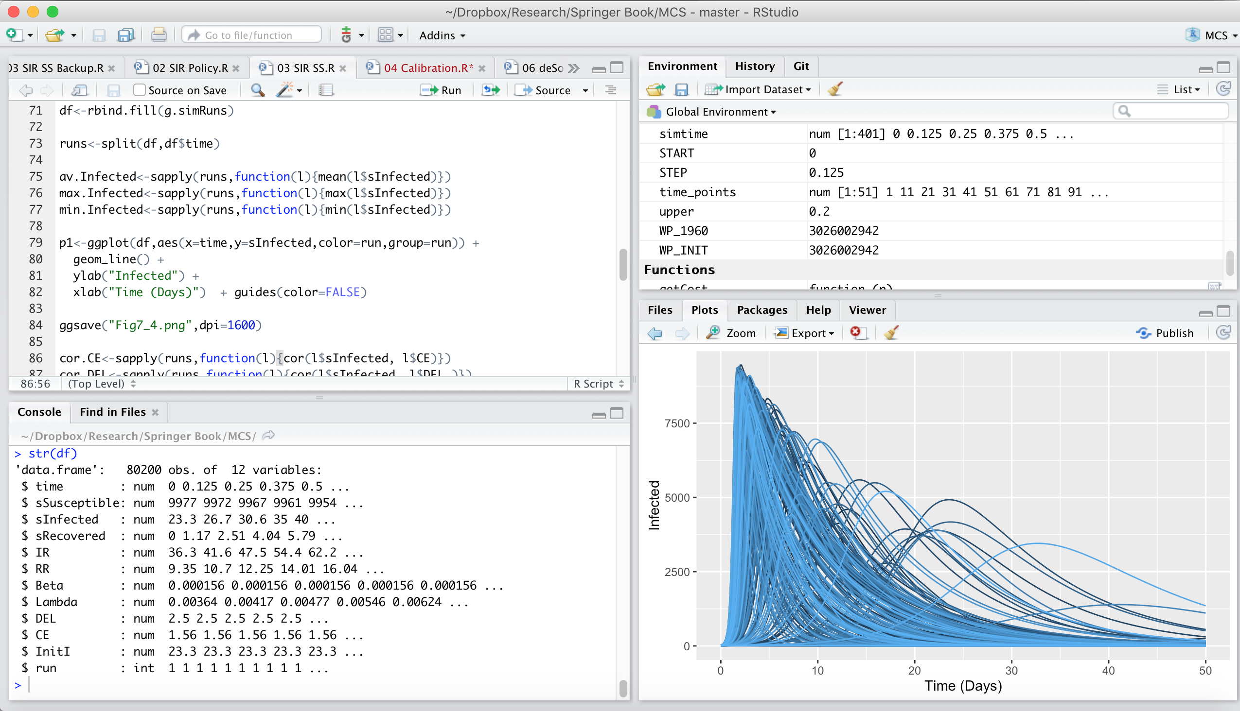
The R Project for Statistical Computing
R’s mission is to enable the best and most thorough exploration of data possible (Chambers 2008).
It is a dialect of the S language, developed at Bell Laboratories
ACM noted that S “will forever alter the way people analyze, visualize, and manipulate data”

Slide 4
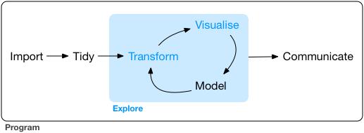
Data Exploration
“Data exploration is the art of looking at your data, rapidly generating hypotheses, quickly testing them, then repeating again and again and again.” (Wickham and Grolemund 2017).

Slide 5
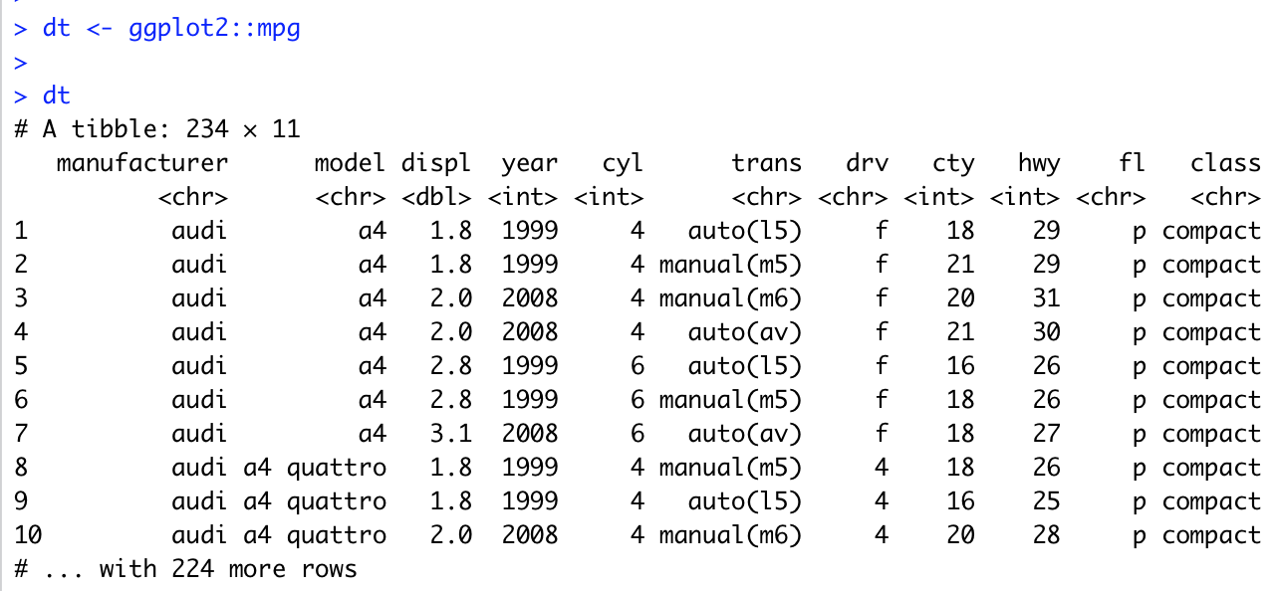
Data Visualisation with ggplot2
“The simple graph has brought more information to the data analyst’s mind that any other device.” – John Tukey

Slide 6
Fuel Economy Data Set (ggplot2::mpg)
This dataset contains a subset of the fuel economy data that the EPA makes available on http://fueleconomy.gov. It contains only models which had a new release every year between 1999 and 2008 - this was used as a proxy for the popularity of the car.
manufacturer | manufacturer | drv | f = front-wheel drive, r = rear wheel drive, 4 = 4wd
model | model name | cty | city miles per gallon
displ | engine displacement, in litres | hwy | highway miles per gallon
year | year of manufacture | fl | fuel type
cyl | number of cylinders | class | “type” of car
trans | type of transmission

Slide 7
First Steps
Generate a first graph to help answer the following question:
Do cars with big engines use more fuel than cars with small engines
What might the relationship between engine size and fuel efficiency look like?
Positive or negative?
Linear or non-linear?

Slide 8
Selecting data
Among the variables are:
displ, a car’s engine size in litres
hwy, a car’s fuel efficiency on the highway in miles per gallon

Slide 9
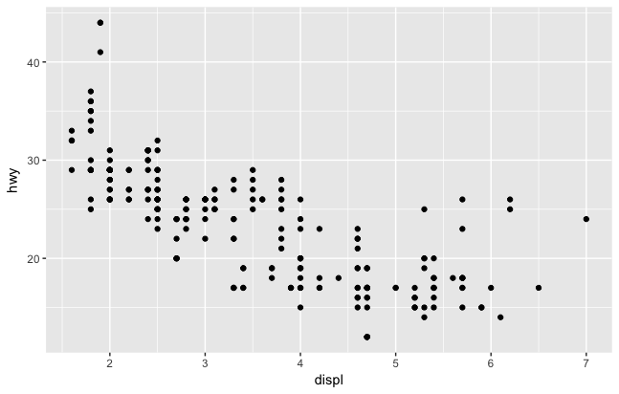
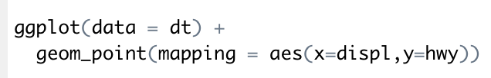
Creating a ggplot

Slide 10
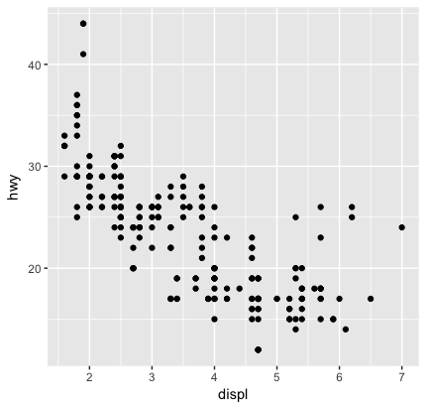
Interpreting the plot
The plot shows a negative relationship between engine size (displ) and fuel efficiency (hwy)
Cars with big engines use more fuel
Does this confirm or refute your hypothesis about fuel efficiency and engine size?

Slide 11
A Graphing Template in R
Turn the code into a reusable template for making graphs with ggplot2
ggplot(data = <DATA>) +
<GEOM_FUNCTION>(mapping = aes(<MAPPINGS>))

Slide 12
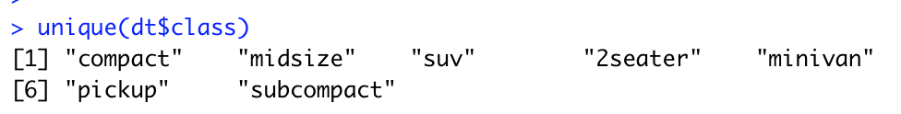
Aesthetic Mappings
“The greatest value of a picture is when it forces us to notice what we never expected to see” – John Tukey
A third variable can be added to a 2-D plot by mapping it to an aesthetic.
An aesthetic is a visual property of the plot’s objects.
An aesthetic’s level could be colour, size or shape.

Slide 13
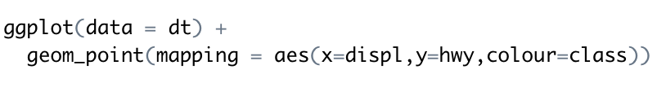
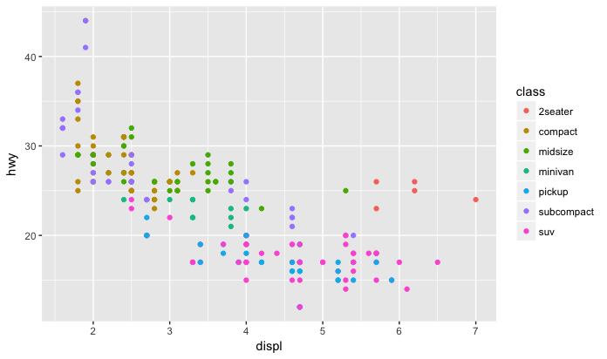

Slide 14
Facets
Another way to add categorical variables is to split a plot into facets, subplots that display one subset of the data.
To facet your plot by a single variable, use facet_wrap()

Slide 15
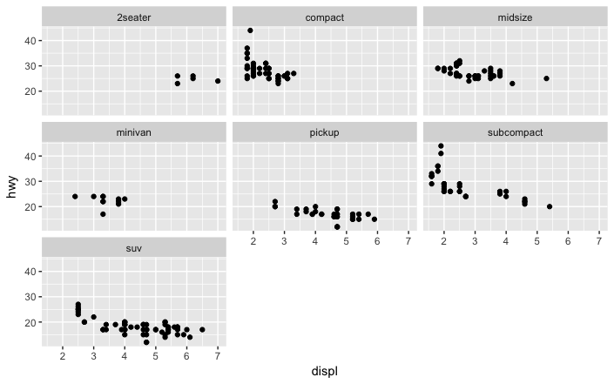

Slide 16
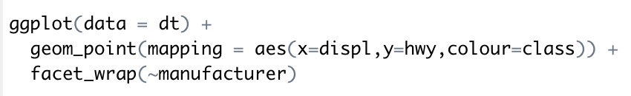
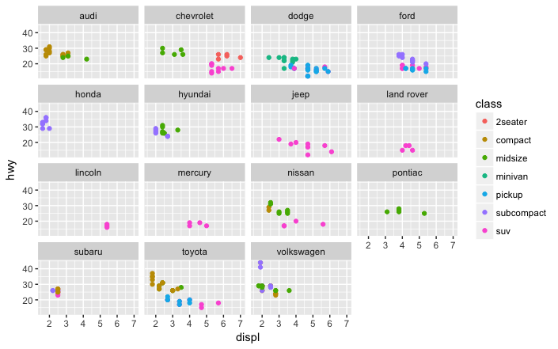

Slide 17
Challenge 1.1
Explore the faithful data set
x = waiting time
y = eruption time
Add a linear model

